Slide 1
michael vs mcgrath
19Times
Batch 5 Group 1

Slide 2
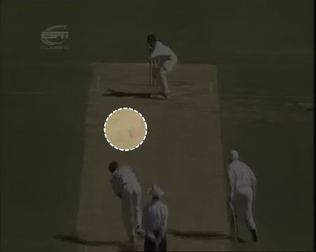
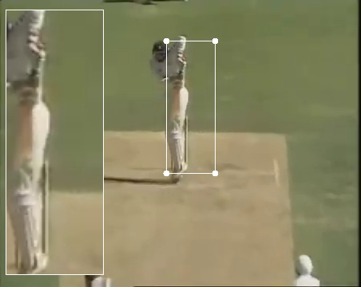
Dismissal 1
Short Ball
Jump

Slide 3
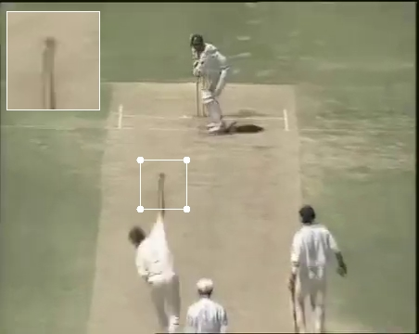
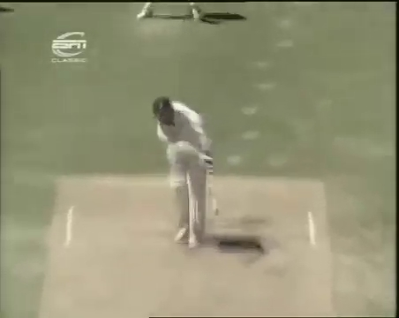
Dismissal 2
Inswing
Flick

Slide 4
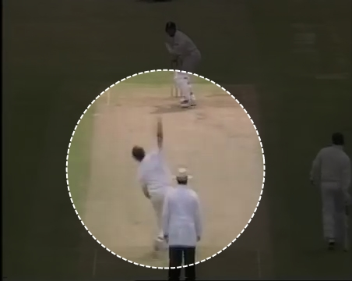
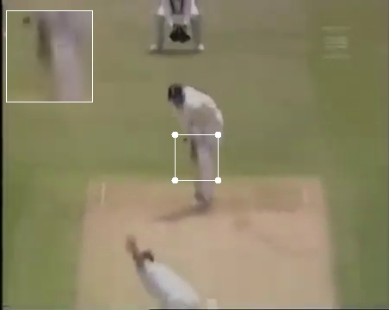
Dismissal 3
Outside off-Full
Lack of Foot work

Slide 5
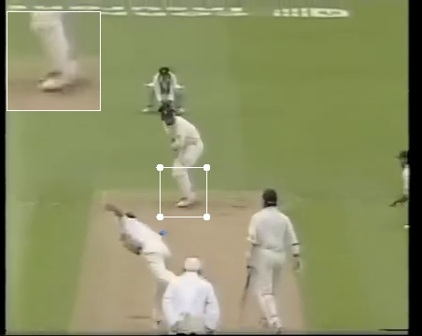
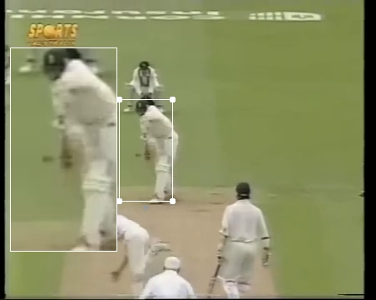
Dismissal 4
Lack of foot Work
Back Foot

Slide 6
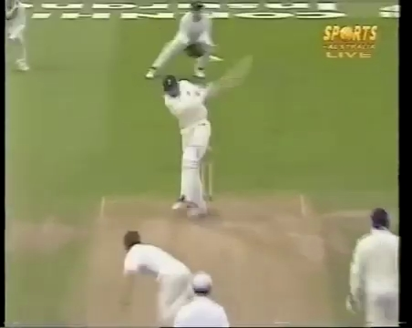
Dismissal 5
Pull Shot

Slide 7
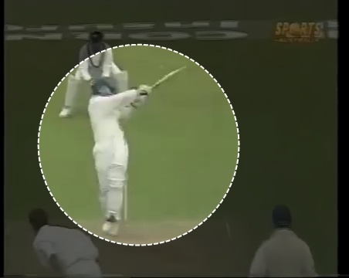
Dismissal 6
Pull Shot - Jump

Slide 8
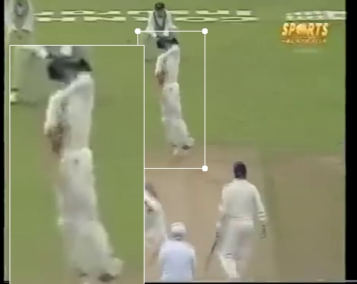
Dismissal 7
Jump

Slide 9
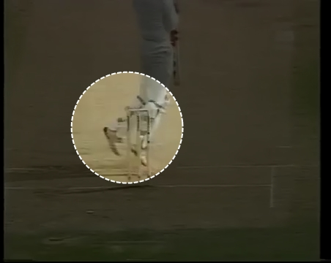
Dismissal 8
Short Ball
Jump

Slide 10
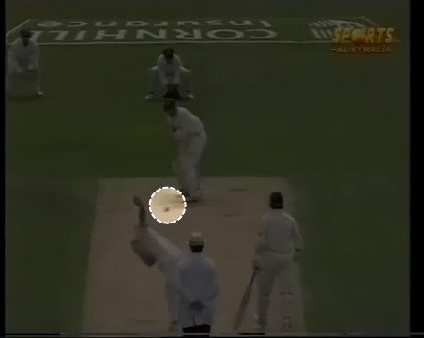
Dismissal 9
Full Inswing

Slide 11
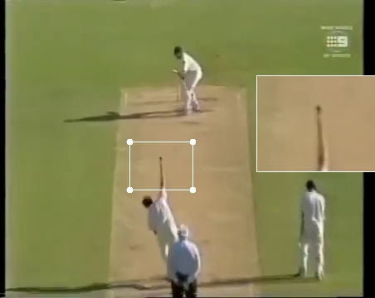
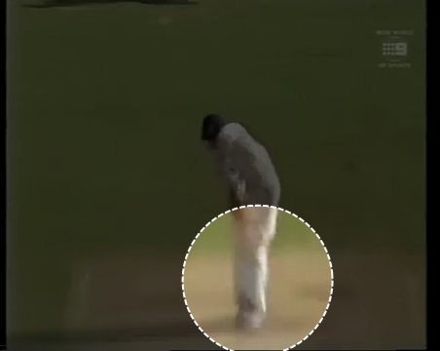
Dismissal 10
Inswing
Jump

Slide 12
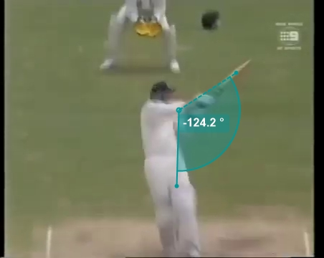
Dismissal 11
Wrong Pull

Slide 13
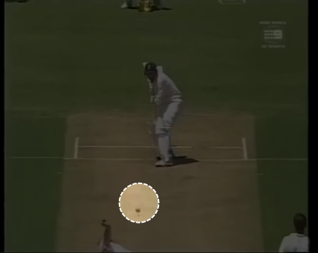
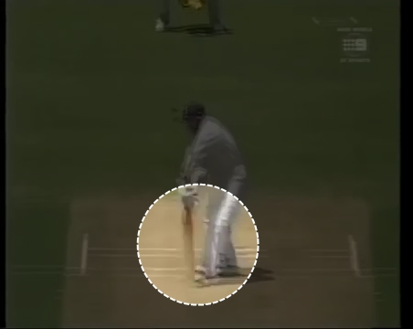
Dismissal 12
Lack of Footwork
Good Length

Slide 14
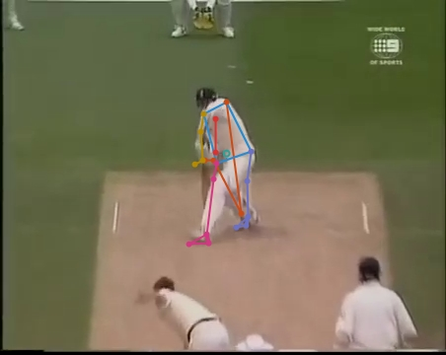
Dismissal 13
Wrong Shot

Slide 15
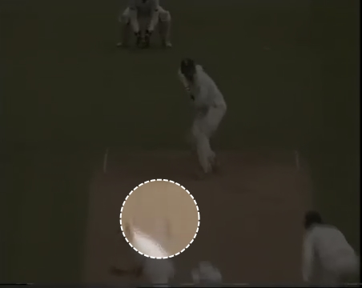
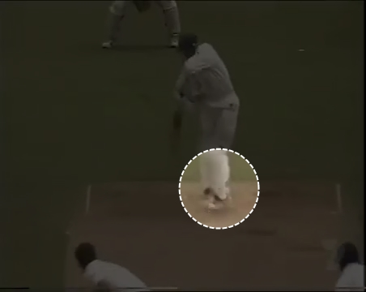
Dismissal 14
Short Ball
Foot Work

Slide 16
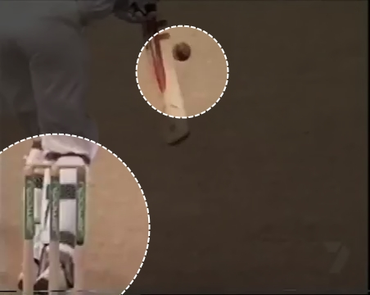
Dismissal 15
Outside off

Slide 17
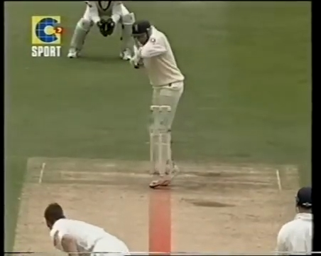
Dismissal 16
Jump

Slide 18
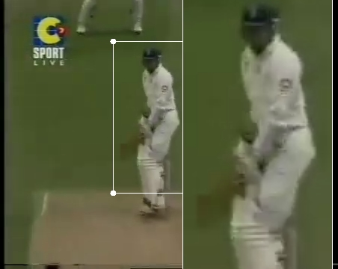
Dismissal 17
BackFoot

Slide 19
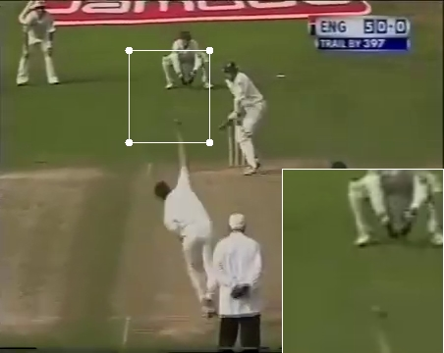
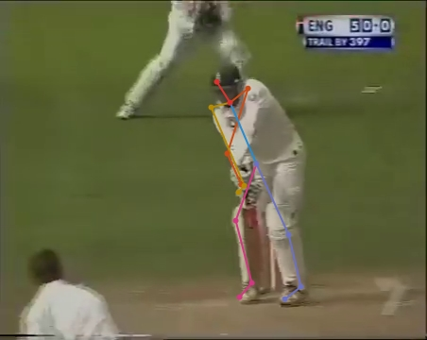
Dismissal 18
Inswing
Wrong Shot

Slide 20
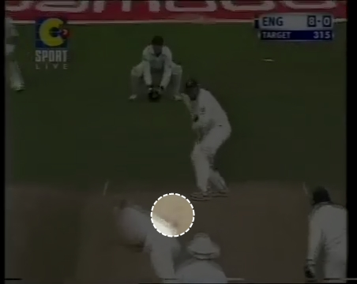
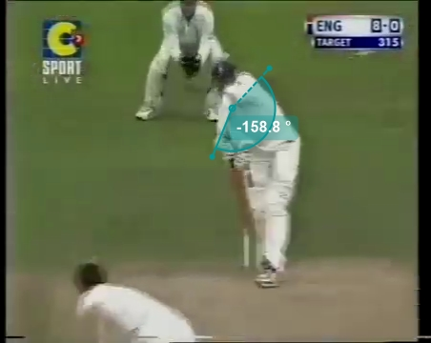
Dismissal 19
Good Length
Bat Angle

Slide 21
Reasons
Lack of Footwork:
The batsman struggles with foot movement, making it challenging to get into the right position to play shots effectively. This results in playing away from the body, mistiming the ball, and getting caught behind or in the slips.
Poor footwork against short or inswinging deliveries can cause the batter to misjudge the line, leading to edges that are easily caught by the wicketkeeper or slips.
Pulled and Inswinging Short Ball:
The short, inswinging ball is a particular challenge due to the batter's inability to adjust to the bounce and movement.
The batsman often misjudges the bounce, getting cramped for room while attempting to pull or hook the ball, which results in playing an aerial shot or edging the ball to the wicketkeeper or slips.

Slide 22
Reasons
Wrong Shot Intent:
The batsman’s intent while playing short-pitched or inswinging deliveries seems misguided, often attempting shots like the flick, off-drive, or defensive shots when the ball demands a different response.
The flick shot is often played to balls on the off-side, which can lead to the ball being edged behind or to the slips.
The off-drive is attempted on short or rising deliveries that need a more controlled shot, which increases the risk of mis-hitting.
The defensive shot is often played without proper foot movement, leading to poor timing and resulting in edges or balls that just miss the stumps.
Common Dismissals:
Caught behind
Caught in the slips
Caught at mid wicket and square

Slide 23
Thank you

